Slide 1
Working with NuGet Packages

Slide 2
Packages
Collection of artifacts to use in your software development pipeline
Like a present from the internet
Sometimes with a pretty bow
Internal or External

Slide 3
Package Manager
Application to track/install/uninstall packages locally
Also for versioning
NuGet, Packet, NPM, Yarn, Brew, etc

Slide 4
Consuming a NuGet Package
2 ways to track packages
Packages.config file
PackageReference
Settings are per-project

Slide 5
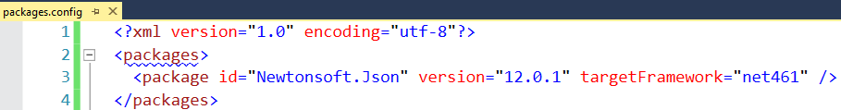
Packages.config
XML file in project directory
Packages downloaded locally per-solution
<SOLUTION ROOT>/packages
Default Choice in Visual Studio
Not meant for live edits
Legacy/Not supported for .NET Core/Standard

Slide 6
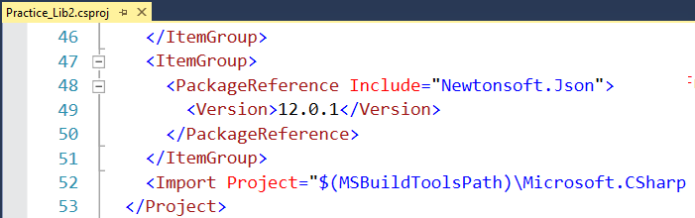
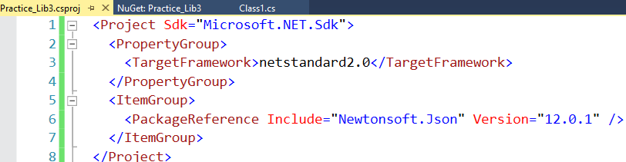
PackageReference
Stored in Project file
Packages downloaded/shared globally on local machine
`dotnet nuget locals all --list`
Only choice for .NET Core/Standard
.NET Framework Project
.NET Standard Project

Slide 7
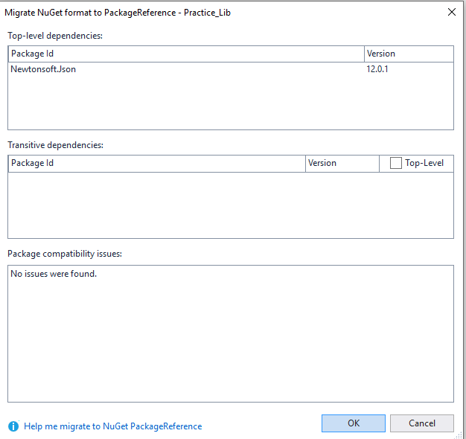
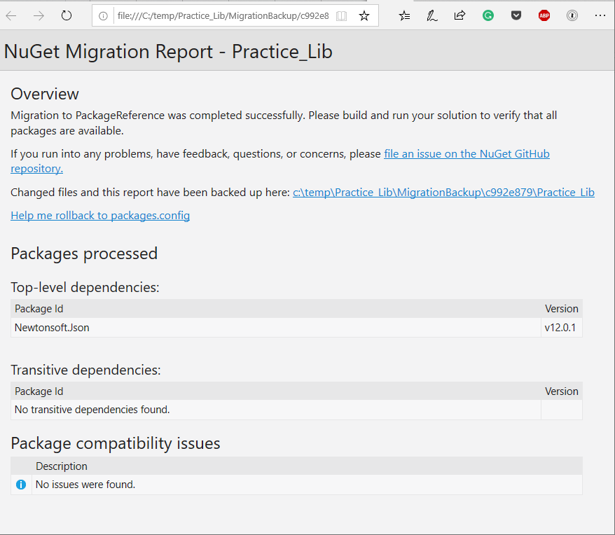
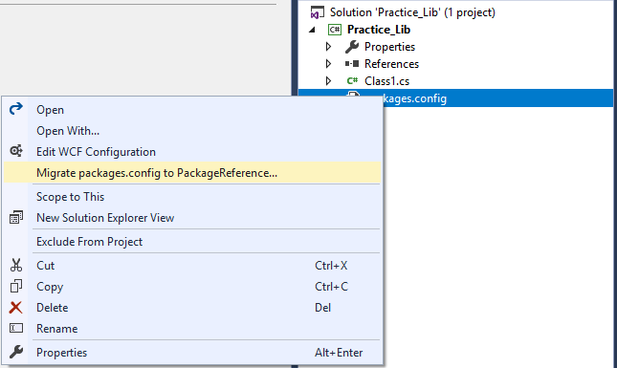
Migrating Packages.config to Package Reference
Analyzer
Report
Built into Visual Studio
Analyzer runs first
HTML report after migration
Right Click Packages.config

Slide 8
PackageReference Breaking Changes
File references only
No install.ps1 and uninstall.ps1 script execution
Files in ‘content’ folder not automatically added to project

Slide 9
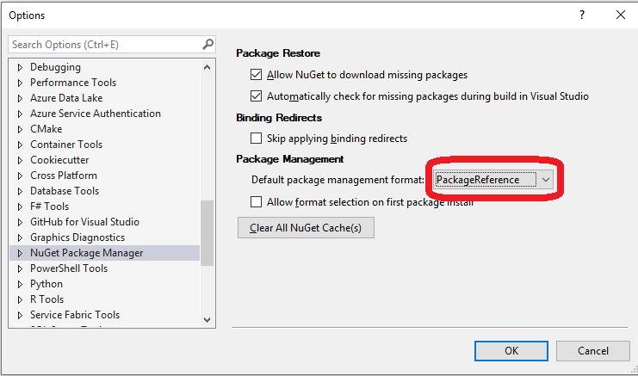
Make PackageReference the Default

Slide 10
Creating a NuGet Package: .NET Framework
In Visual Studio, Fill out info for Application (project properties)
Also info inside “Assembly Information…” button
Compile Library
Download nuget.exe
From within Project Folder, Run command: nuget spec
Generates .nuspec file
Update .nuspec file if needed
From within project folder, Run command: nuget pack

Slide 11
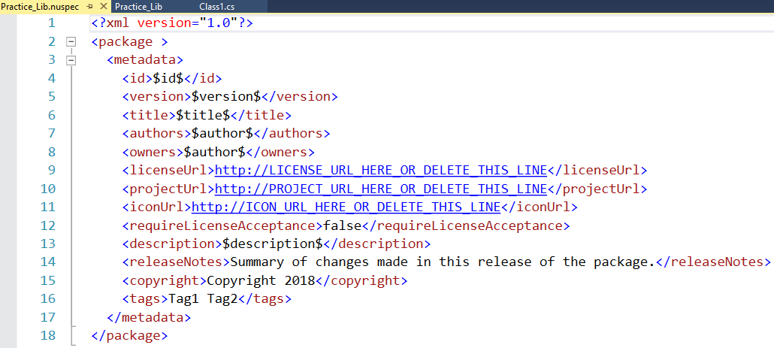
Sample .nuspec file for project
Generated with nuget.exe
Some properties taken from project data
Not all properties required

Slide 12
Creating a NuGet Package: .NET Standard
In Visual Studio, Fill out info for Package (project properties)
Right Click project -> Pack
See package created at:
<Project>\bin\Debug\Practice_Lib3.1.0.0.nupkg
Note: Can do similar work with dotnet CLI

Slide 13
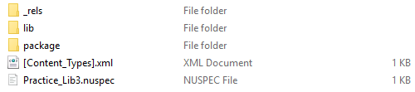
Anatomy of a NuGet Package
Files!
Package is a zip folder
Folder Structure – Not Well Documented
Lib/Content/Build/Tools

Slide 14

Publishing a Package
Let others consume a package to their project
Can “Push” to NuGet server
Command line, or Visual Studio (.NET Standard only)
Setup CI/CD Pipeline

Slide 15
Challenges - Publishing in CI/CD Environment
Can’t change version number after file creation
Can’t change any files after file creation

Slide 16
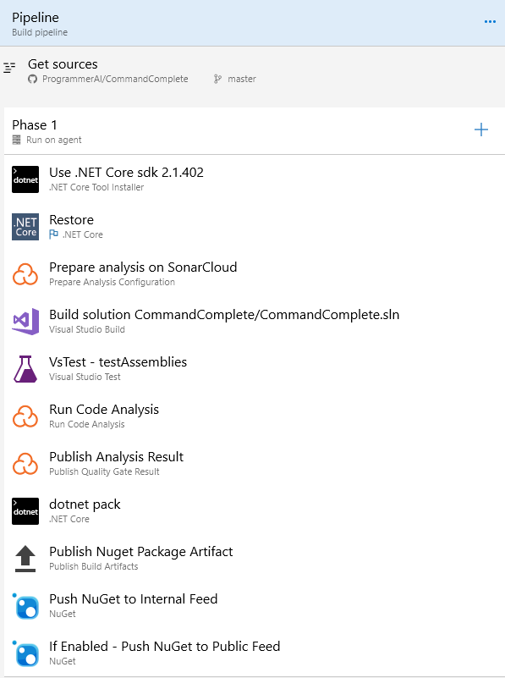
Publish Pipeline in Azure DevOps

Slide 17
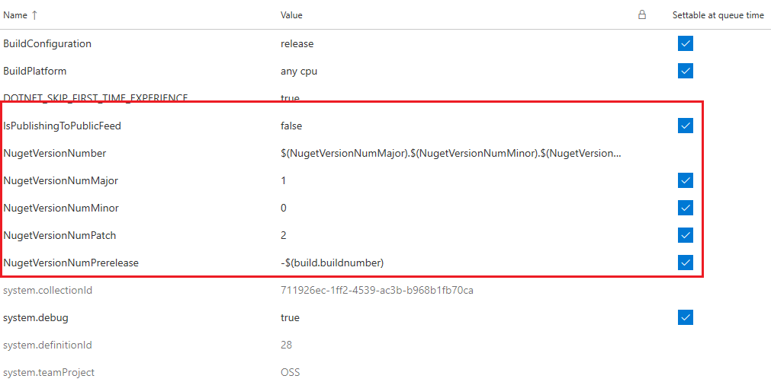
Pipeline Variables

Slide 18
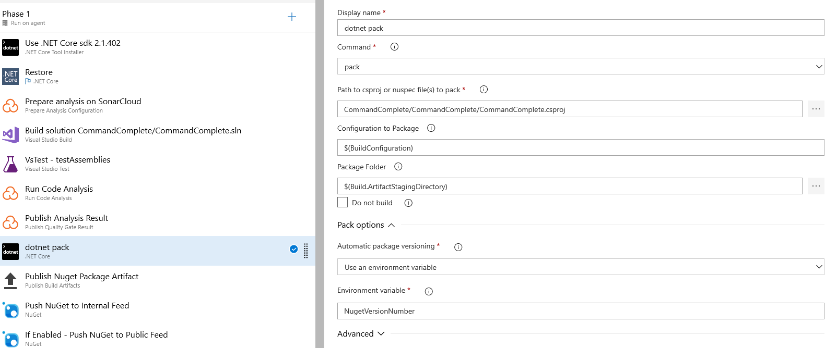
Step 8 – dotnet pack

Slide 19
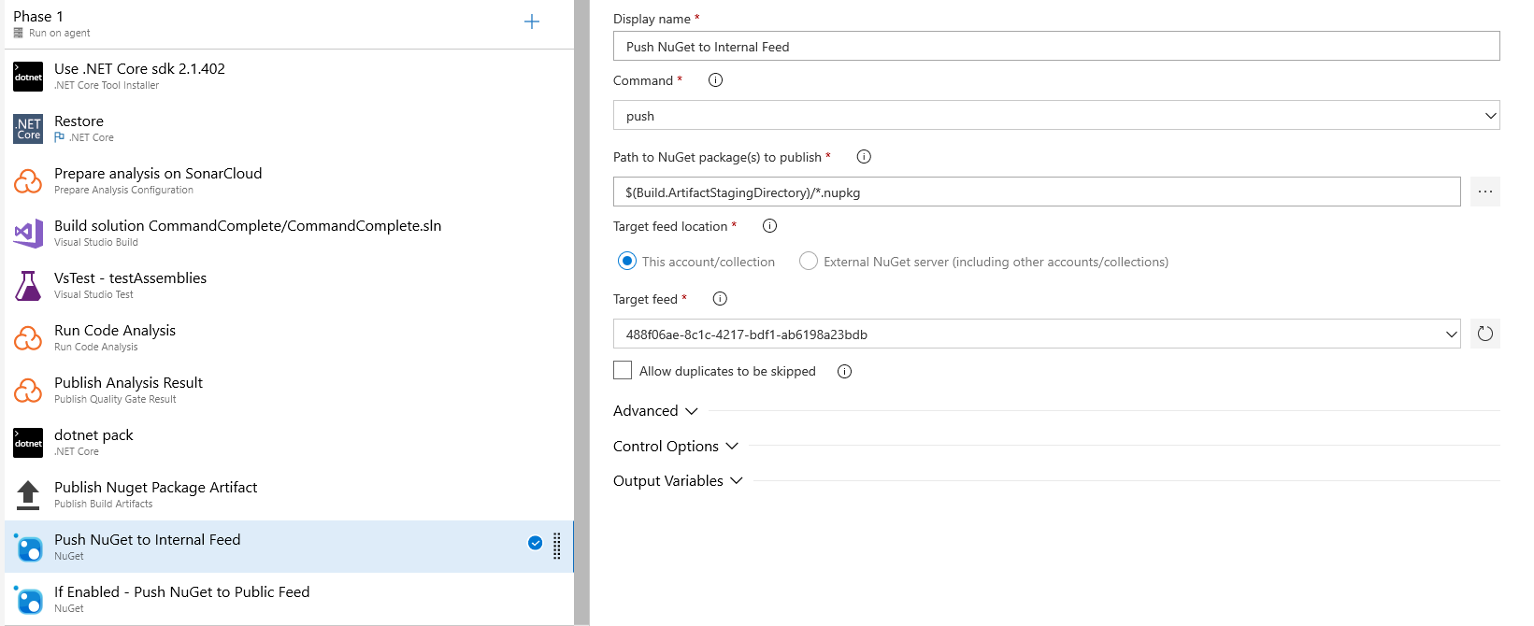
Step 10 – Push to Internal NuGet Feed

Slide 20
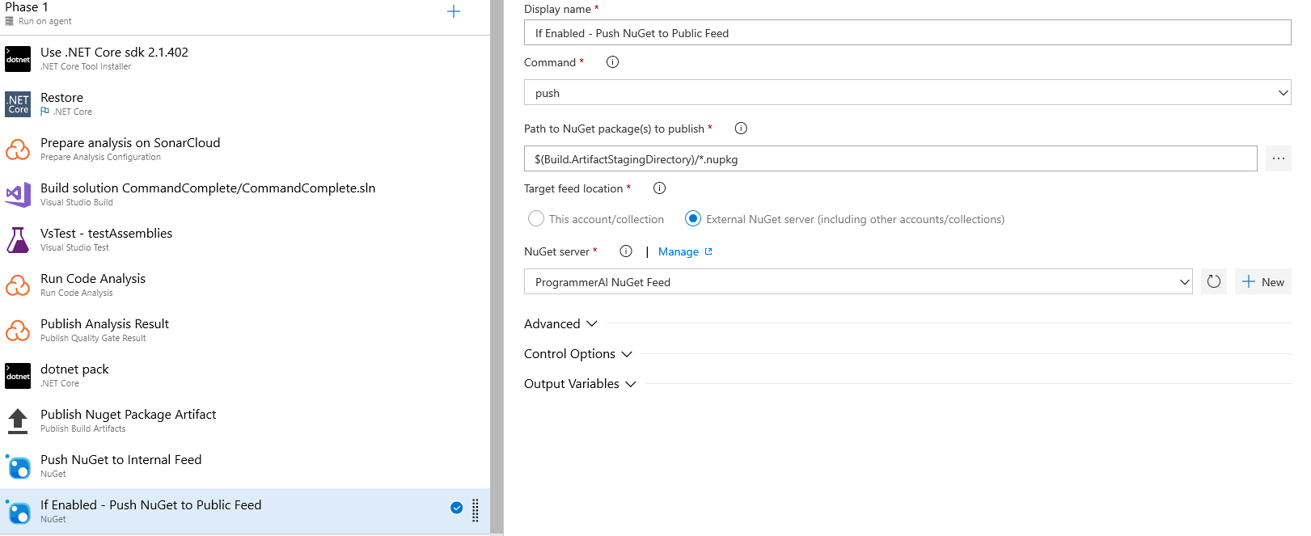
Step 11 – Push to Public NuGet Feed

Slide 21
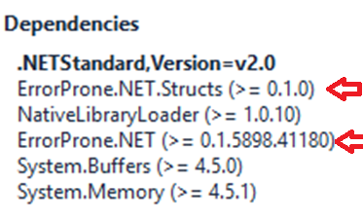
Don’ts
Ship developer dependencies
Set the PrivateAssets attribute
<PackageReference Include="ErrorProne.NET" Version="0.1.5898.41180" PrivateAssets="All" />

Slide 22
Tangent - .NET Debugging Information
Terms
Portable – .NET Core only. PDB files created with assemblies
Embedded – PDB info part of the assembly
Everything Else – Windows Only
Not all PDB files work everywhere
Traditionally Windows Only

Slide 23
Debugging a Package
Symbol Packages
SourceLink
Embedded Symbols
Embedded Source

Slide 24
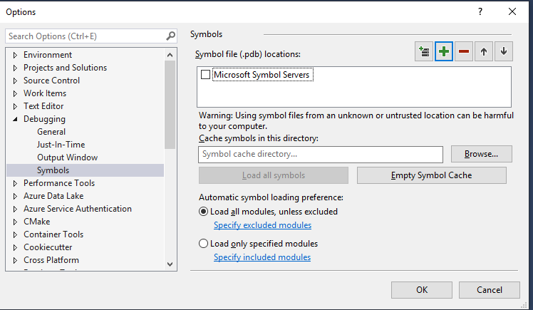
Symbol Packages
Separate *.snupkg file you also upload to NuGet server
NuGet Packages only containing PDBs for debugging
dotnet pack MyPackage.csproj --include-symbols -p:SymbolPackageFormat=snupkg
https://docs.microsoft.com/en-us/nuget/create-packages/symbol-packages-snupkg

Slide 25
NuGet Symbol Server
Portable PDBs ONLY in NuGet (for now)
Files must be compiled with Visual Studio 15.9+
In Visual Studio, add NuGet server as a new symbol server
https://symbols.nuget.org/download/symbols

Slide 26
Pros/Cons
Pros
Package version is specific to NuGet package
Cons
Requires Internet Connection to Debug
Another file to keep track of

Slide 27
SourceLink
Package has embedded link to source code
GitHub, Azure DevOps, TFS, GitLab
.NET Core SDK 2.1.300 or newer
Open Source Initiative
https://github.com/dotnet/sourcelink

Slide 28
SourceLink cont.
Pros
Direct link to code
Cons
Requires Internet Connection to Debug
Code/Symbols can get out of sync
Creation part of same process when creating package

Slide 29
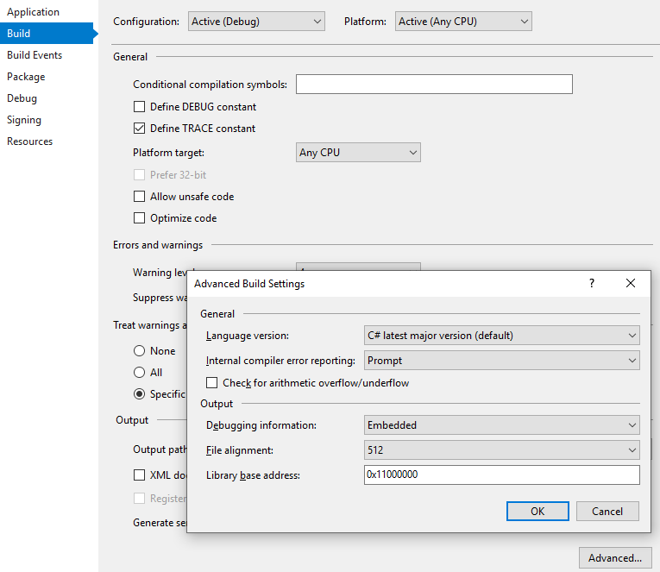
Embedded Symbols
Debug symbols are embedded in the *.dll files
NOT a NuGet thing
.NET project setting

Slide 30
Embedded Source
Planned for the future
Not Created Yet
Cons:
Doesn’t Exist
Greatly increases size of NuGet package

Slide 31
Bonus: dotPeek
JetBrains Decompiler application
Free
Decompile DLL
Generate PBD
Act as a Symbol Server

Slide 32
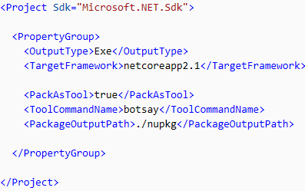
Global Tools
Only create with dotnet.exe
Command Line Applications only
‘PackAsTool’ csproj property
Community List
https://github.com/natemcmaster/dotnet-tools
INSTALL AT YOUR OWN RISK
Like every other package

Slide 33
Native Packages
C/C++ packages
Very little documentation
Consider using vcpkg instead
https://docs.microsoft.com/en-us/cpp/vcpkg?view=vs-2017

Slide 34
Signing Packages
Allows automated checks against content tampering
Requires purchasing code signing certificate
Cheapest I saw: $125/year at minimum 2 years
Can use self signed certificate for local testing purposes
Must register certificate with NuGet server
nuget sign MyPackage.nupkg -CertificateFilePath <PathToTheCertificate> -Timestamper <TimestampServiceURL>
https://docs.microsoft.com/en-us/nuget/create-packages/sign-a-package

Slide 35
Strong Naming

